Slide 1
Semi-supervised learning and multi-target prediction
Jurica Levatić
Institute for Research in Biomedicine, Barcelona, Spain
jurica.levatic@irbbarcelona.org
SSDS 2018, Split
September 26th, 2018

Slide 2
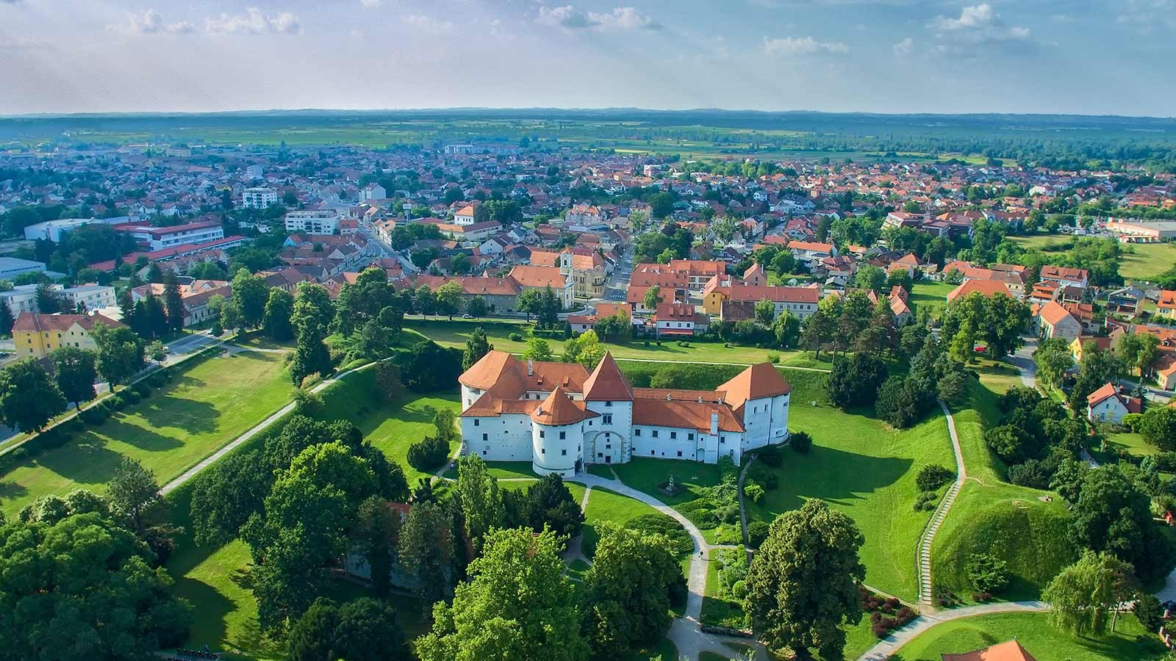
Born in Varaždin, Croatia

Slide 3
Education
2011 MSc in Mathematics and Computer Science Faculty of Science, University of Zagreb, Croatia
Thesis: Techniques of semi-supervised learning Supervisor: Prof. Tomislav Šmuc
2017 PhD in Computer Science Jožef Stefan International Postgraduate School, Ljubljana, Slovenia
Thesis: Semi-supervised learning for structured output prediction Supervisor: Prof. Sašo Džeroski

Slide 4
Work
2011-2012 BioZyne Ltd., Zagreb, Croatia • Research associate • Machine learning, chemoinformatics
2013-2017 Jožef Stefan Institute, Ljubljana, Slovenia • Young researcher • Structured output prediction, semi-supervised learning applications in ecology, life sciences, space technology, …
2017- Institute for Research in Biomedicine, Barcelona, Spain • Postdoc • Bioinformatics, cancer biology

Slide 5

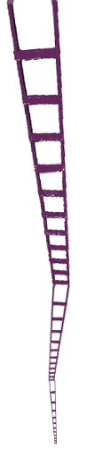
Machine learning studies algorithms that can learn from data, make predictions on data and improve with experience (Mitchell, 1997)

Slide 6
Supervised and semi-supervised learning
Labeled data
 | Descriptive space |  |  |  | Target space
Example 1 | 1 | TRUE | 0.49 | 0.69 | 0.68 | 3.91
Example 2 | 2 | FALSE | 0.08 | 0.07 | 0.56 | 7.59
Example 3 | 1 | FALSE | 0.08 | 0.07 | 0.10 | 7.57
Example 4 | 2 | TRUE | 0.49 | 0.69 | 0.08 | 8.86
… | … |  |  |  | … | …

Slide 7
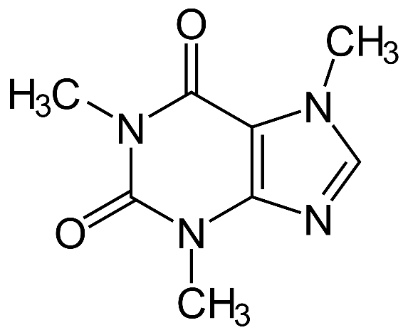
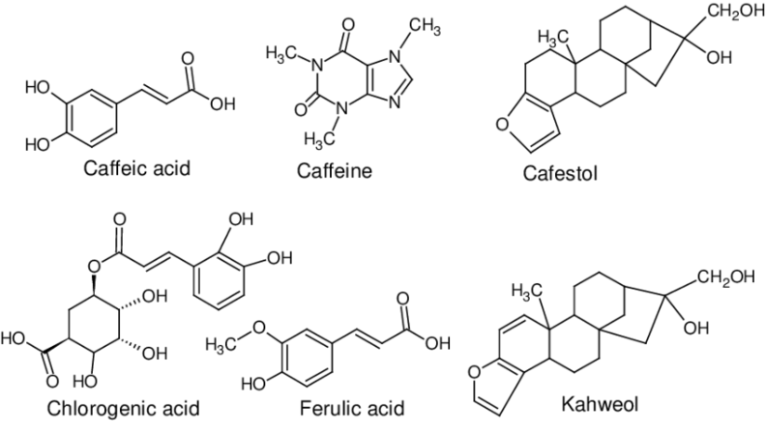
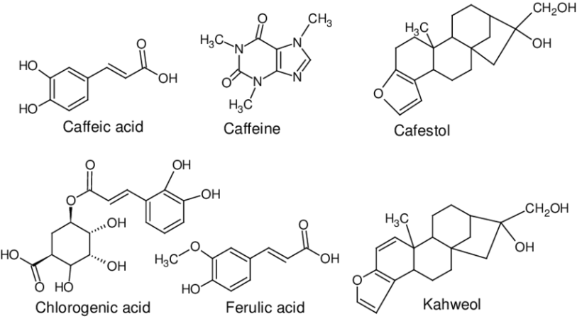
Supervised and semi-supervised learning
Labeled data
 | Descriptive space |  |  |  | Target space
Example 1 | 1 | TRUE | 0.49 | 0.69 | 0.68 | 3.91
Example 2 | 2 | FALSE | 0.08 | 0.07 | 0.56 | 7.59
Example 3 | 1 | FALSE | 0.08 | 0.07 | 0.10 | 7.57
Example 4 | 2 | TRUE | 0.49 | 0.69 | 0.08 | 8.86
… | … |  |  |  | … | …
Kills cancer cells?
MCF7
HeLa
?

Slide 8



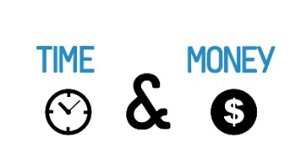

Supervised and semi-supervised learning
Labeled data
 | Descriptive space |  |  |  | Target space
Example 1 | 1 | TRUE | 0.49 | 0.69 | 0.68 | 3.91
Example 2 | 2 | FALSE | 0.08 | 0.07 | 0.56 | 7.59
Example 3 | 1 | FALSE | 0.08 | 0.07 | 0.10 | 7.57
Example 4 | 2 | TRUE | 0.49 | 0.69 | 0.08 | 8.86
… | … |  |  |  | … | …
Kills cancer cells?
MCF7
HeLa

Slide 9
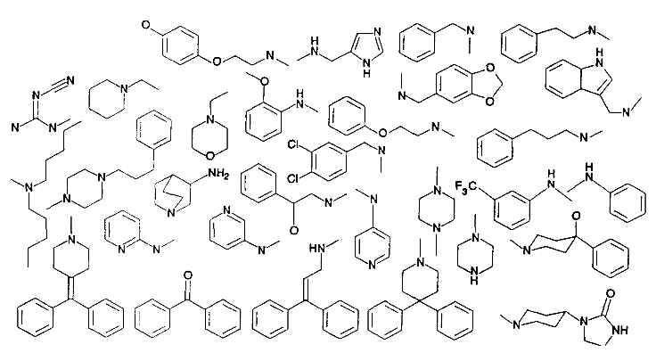
Supervised and semi-supervised learning
Labeled data
 | Descriptive space |  |  |  | Target space
Example 1 | 1 | TRUE | 0.49 | 0.69 | 0.68 | 3.91
Example 2 | 2 | FALSE | 0.08 | 0.07 | 0.56 | 7.59
Example 3 | 1 | FALSE | 0.08 | 0.07 | 0.10 | 7.57
Example 4 | 2 | TRUE | 0.49 | 0.69 | 0.08 | 8.86
… | … |  |  |  | … | …
Unlabeled data
Example N+1 | 1 | TRUE | 0.86 | 0.35 | ? | ?
Example N+2 | 2 | FALSE | 0.09 | 0.05 | ? | ?
Example N+3 | 4 | FALSE | 0.07 | 0.01 | ? | ?
Example N+4 | 2 | TRUE | 0.91 | 0.78 | ? | ?
Example N+5 | 2 | TRUE | 0.42 | 0.69 | ? | ?
… | … |  |  |  | … | …
Kills cancer cells?
MCF7
HeLa
?
Drug candidates

Slide 10
Supervised and semi-supervised learning
Labeled data
 | Descriptive space |  |  |  | Target space
Example 1 | 1 | TRUE | 0.49 | 0.69 | 0.68 | 3.91
Example 2 | 2 | FALSE | 0.08 | 0.07 | 0.56 | 7.59
Example 3 | 1 | FALSE | 0.08 | 0.07 | 0.10 | 7.57
Example 4 | 2 | TRUE | 0.49 | 0.69 | 0.08 | 8.86
… | … |  |  |  | … | …
Unlabeled data
Example N+1 | 1 | TRUE | 0.86 | 0.35 | ? | ?
Example N+2 | 2 | FALSE | 0.09 | 0.05 | ? | ?
Example N+3 | 4 | FALSE | 0.07 | 0.01 | ? | ?
Example N+4 | 2 | TRUE | 0.91 | 0.78 | ? | ?
Example N+5 | 2 | TRUE | 0.42 | 0.69 | ? | ?
… | … |  |  |  | … | …
Kills cancer cells?
MCF7
HeLa
?
Drug candidates
Learn
Supervised
model
Predict

Slide 11
Supervised and semi-supervised learning
Labeled data
 | Descriptive space |  |  |  | Target space
Example 1 | 1 | TRUE | 0.49 | 0.69 | 0.68 | 3.91
Example 2 | 2 | FALSE | 0.08 | 0.07 | 0.56 | 7.59
Example 3 | 1 | FALSE | 0.08 | 0.07 | 0.10 | 7.57
Example 4 | 2 | TRUE | 0.49 | 0.69 | 0.08 | 8.86
… | … |  |  |  | … | …
Unlabeled data
Example N+1 | 1 | TRUE | 0.86 | 0.35 | ? | ?
Example N+2 | 2 | FALSE | 0.09 | 0.05 | ? | ?
Example N+3 | 4 | FALSE | 0.07 | 0.01 | ? | ?
Example N+4 | 2 | TRUE | 0.91 | 0.78 | ? | ?
Example N+5 | 2 | TRUE | 0.42 | 0.69 | ? | ?
… | … |  |  |  | … | …
Kills cancer cells?
MCF7
HeLa
?
Learn
Drug candidates
Learn
Semi-supervised
model
Predict

Slide 12
Semi-supervised learning: Motivation
Labeled data is often hard
(expensive and/or time-consuming labeling)
Natural language parsing: 400h to transcribe 1h of speech at the phonetic level
Spam filtering: Manual annotation of emails
Prediction of 3D protein structure from DNA sequence: Months of work to identify the 3D structure of a single protein
Prediction of activity of drugs: Expensive wet-lab experiments
...
Unlabeled data is often freely available in large quantities

Slide 13
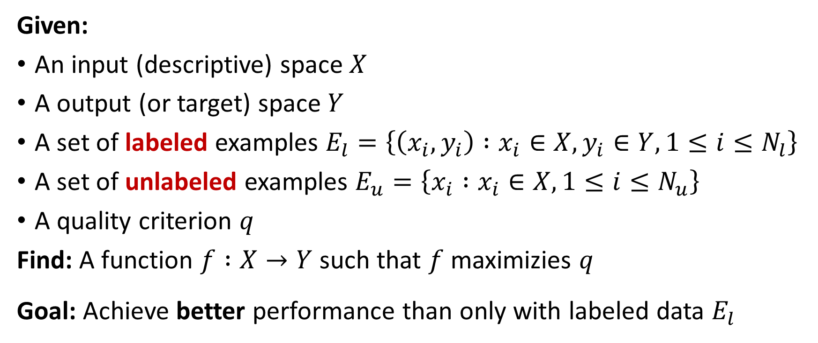
Semi-supervised learning: Definition
Given:
An input (descriptive) space $X$
A output (or target) space $Y$
A set of labeled examples $E_{l}=\left\{\left(x_{i},y_{i}\right) :x_{i}∈X, y_{i}∈Y, 1≤i≤N_{l}\right\}$
A set of unlabeled examples $E_{u}=\left\{x_{i} :x_{i}∈X, 1≤i≤N_{u}\right\}$
A quality criterion $q$
Find: A function $f :X→Y$ such that $f$ maximizies $q$
Goal: Achieve better performance than only with labeled data $E_{l}$

Slide 14
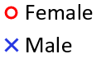
How unlabeled data can help?
Task: Predict gender from person‘s weight and height
Data¹: 10000 entries of height, weight and gender
Assumptions about the labels with respect to the structure of unlabeled data
¹https://helloacm.com/data/gender-height-weight.csv

Slide 15
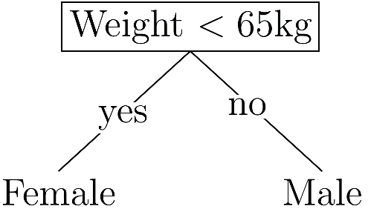
How unlabeled data can help?
Supervised model:
Task: Predict gender from person‘s weight and height
Data¹: 10000 entries of height, weight and gender
Assumptions about the labels with respect to the structure of unlabeled data
¹https://helloacm.com/data/gender-height-weight.csv

Slide 16
How unlabeled data can help?
Supervised model:
Task: Predict gender from person‘s weight and height
Data¹: 10000 entries of height, weight and gender
Assumptions about the labels with respect to the structure of unlabeled data
¹https://helloacm.com/data/gender-height-weight.csv

Slide 17
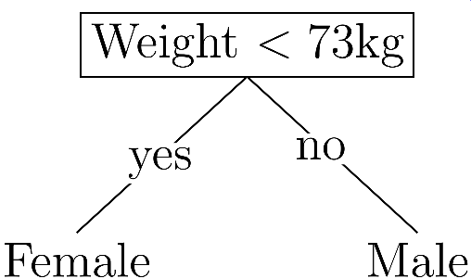
How unlabeled data can help?
Supervised model:
Task: Predict gender from person‘s weight and height
Data¹: 10000 entries of height, weight and gender
Assumptions about the labels with respect to the structure of unlabeled data
Semi-supervised model:
¹https://helloacm.com/data/gender-height-weight.csv

Slide 18
How unlabeled data can help?
Accuracy = 82%
Supervised model:
Task: Predict gender from person‘s weight and height
Data¹: 10000 entries of height, weight and gender
Assumptions about the labels with respect to the structure of unlabeled data
Semi-supervised model:
¹https://helloacm.com/data/gender-height-weight.csv

Slide 19
I. Introduction to semi-supervised learning Classes of methods II. Semi-supervised learning for multi-target prediction My work

Slide 20
I. Introduction to semi-supervised learning Classes of methods II. Semi-supervised learning for multi-target prediction My PhD work
Iterative self-training methods
Generative methods
Low-density separation methods
Graph-based methods

Slide 21

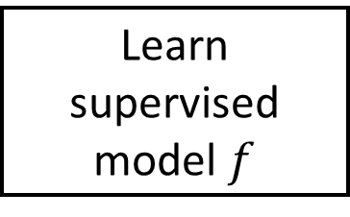

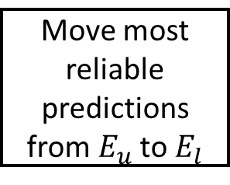
1) Iterative self-training methods
Assumption: reliable predictions are correct
Labeled data $E_{l}$
Unlabeled data $E_{u}$
Learn supervised model $f$
Make predictions
Calculate reliability of predictions
For example:
Empirical probabilities
No
Reliability above threshold
Stopping criterion
Move most reliable predictions from${ E}_{u}$ to $E_{l}$
Select most reliable predictions
No unlabeled example passes reliability condition
Yes
Predictive model

Slide 22
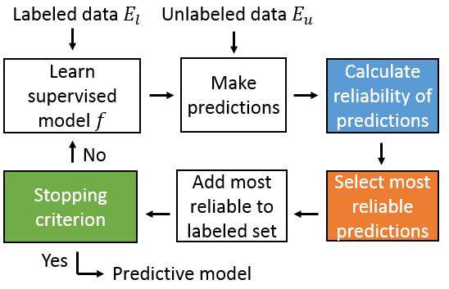
Alternatives: co-training, tri-training,…
Co-training: two models trained on different (complementary) feature sets, exchanging predictions

Slide 23
Self-training methods
Advantages:
The simplest semi-supervised method
„Wrapper“ method
Good results in natural language processing
Disadvantages:
Error propagation – mistakes reinforce themselves

Slide 24
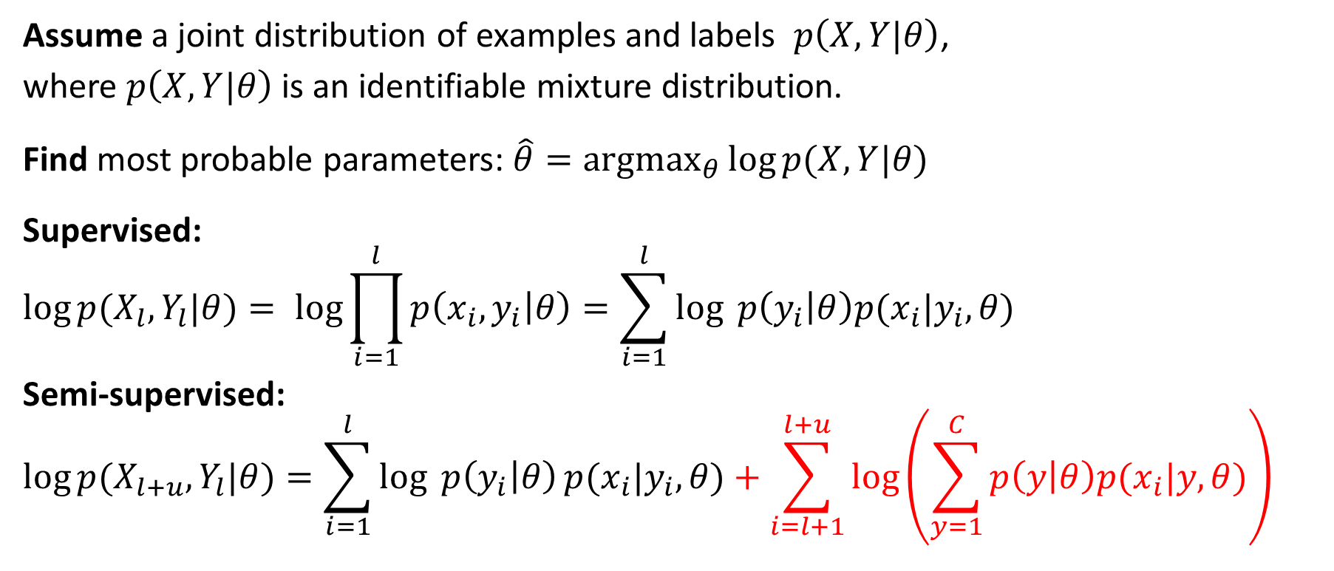
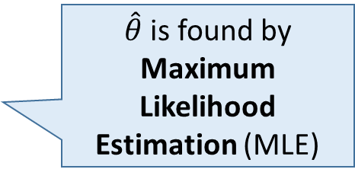
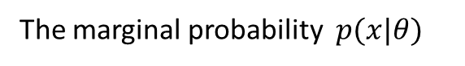
2) Generative methods
Assume a joint distribution of examples and labels $p\left(X,Y|θ\right)$,
where $p\left(X,Y|θ\right)$ is an identifiable mixture distribution.
Find most probable parameters: $\hat{θ}=\underset{θ}{argmax}{\log{p(X,Y|θ)}}$
Supervised:
$$\log{p(X_{l},Y_{l}|θ)}= \log{\prod_{i=1}^{l}{p\left(x_{i},y_{i} | θ\right)=\sum_{i=1}^{l}{\log{ p\left(y_{i} | θ\right)p(x_{i}|y_{i},θ)}}}}$$
Semi-supervised:
$$\log{p(X_{l+u},Y_{l}|θ)}=\sum_{i=1}^{l}{\log{ p\left(y_{i} | θ\right)}p(x_{i}|y_{i},θ)}+\sum_{i=l+1}^{l+u}{\log\left(\sum_{y=1}^{C}{p\left(y | θ\right)p(x_{i}|y,θ)}\right)}$$
Mixture of two Gaussians
$\hat{θ}$ is found by Maximum Likelihood Estimation (MLE)
The marginal probability $p(x|θ)$

Slide 25
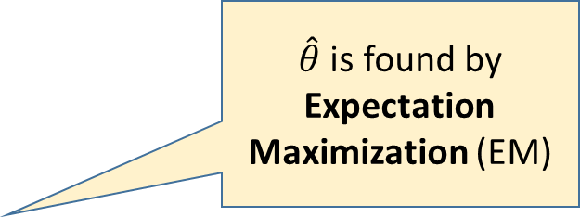
2) Generative methods
Assume a joint distribution of examples and labels $p\left(X,Y|θ\right)$,
where $p\left(X,Y|θ\right)$ is an identifiable mixture distribution.
Find most probable parameters: $\hat{θ}=\underset{θ}{argmax}{\log{p(X,Y|θ)}}$
Supervised:
$$\log{p(X_{l},Y_{l}|θ)}= \log{\prod_{i=1}^{l}{p\left(x_{i},y_{i} | θ\right)=\sum_{i=1}^{l}{\log{ p\left(y_{i} | θ\right)p(x_{i}|y_{i},θ)}}}}$$
Semi-supervised:
$$\log{p(X_{l+u},Y_{l}|θ)}=\sum_{i=1}^{l}{\log{ p\left(y_{i} | θ\right)}p(x_{i}|y_{i},θ)}+\sum_{i=l+1}^{l+u}{\log\left(\sum_{y=1}^{C}{p\left(y | θ\right)p(x_{i}|y,θ)}\right)}$$
Mixture of two Gaussians
$\hat{θ}$ is found by Expectation Maximization (EM)
The marginal probability $p(x|θ)$

Slide 26
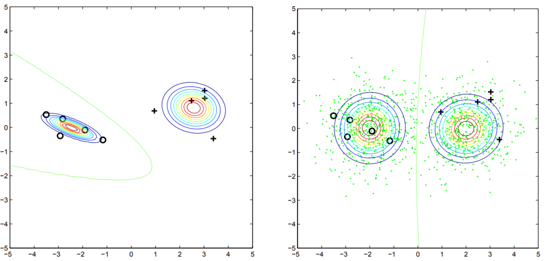
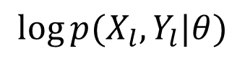
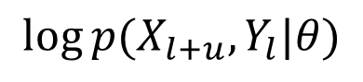
Example: 2-component Gaussian mixture models
$$\log{p(X_{l},Y_{l}|θ)}$$
$$\log{p(X_{l+u},Y_{l}|θ)}$$
Figure: Zhu, ICML 2007

Slide 27
Generative methods
Commonly used probabilistic models:
Gaussians Mixture Models (image classification)
Multinomial Mixture Models (text categorization)
Hidden Markov Models (speech recognition)
Advantages:
Probabilistic framework
Can give good results with few labeled data if the assumed model is correct
Disadvantages:
Difficult to assess the correctness of an assumed probabilistic model
Wrong model can result in bad performance

Slide 28
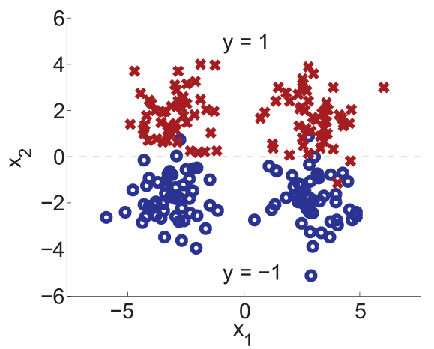
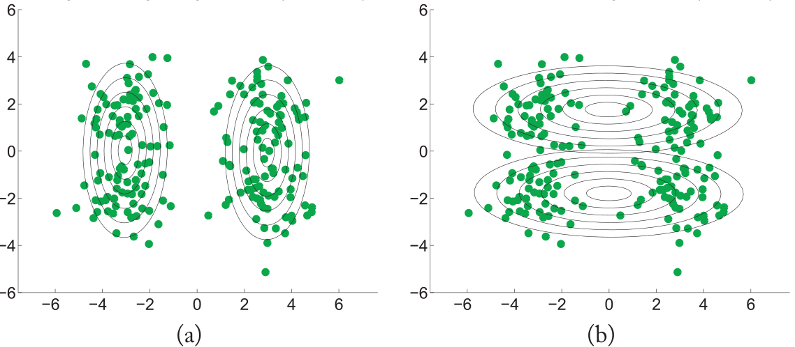
Generative methods
Disadvantages:
Difficult to assess the correctness of an assumed probabilstic model
Wrong model can result in bad performance
Wrong model/high likelihood
(each class ↔ 1 Gaussian)
Right model/low likelihood
(each class ↔ 2 Gaussians)
True labels
Figure: Zhu and Goldberg (2009)

Slide 29
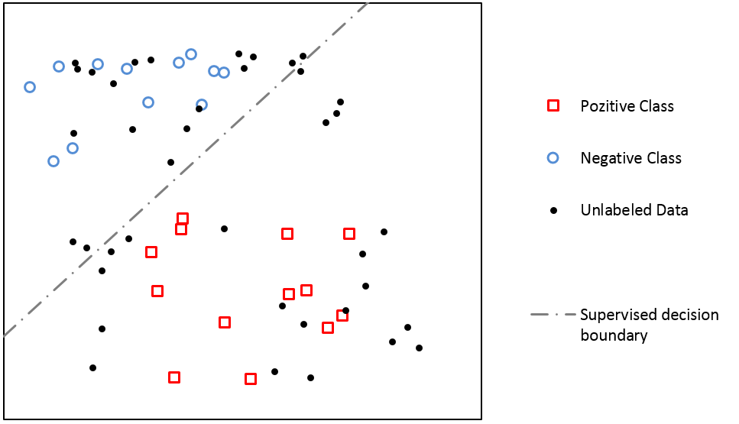
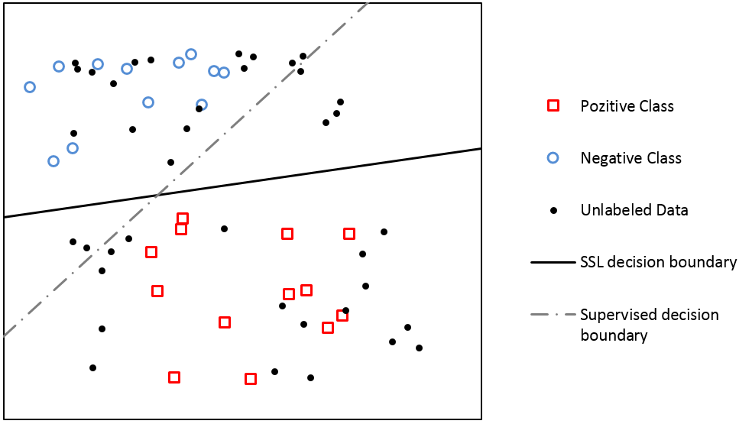
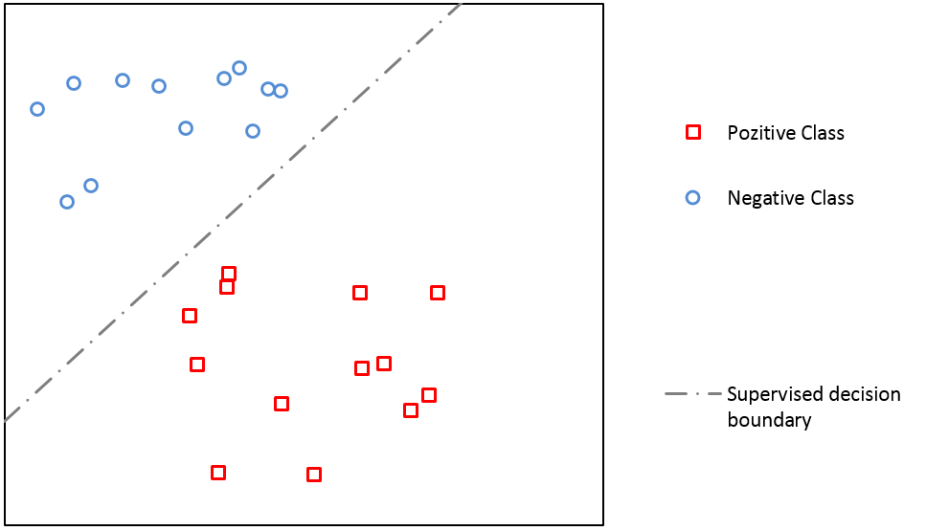
3) Low-density separation methods Semi-supervised support vector machines
Assume the decision boundary should lie in a low-density region of input space.
⬄
If the examples are in the same cluster, they are likely of the same class
Notes:
For the beginning lets illustrate SSL on one simple expample. We will seee how unlabeled data can help to build better predictive model.
We have some 2D data and two classes, red one and the blue one. If we apply classifier which separate classes by finding the biggest gap, e.g., linear support vector machines we will get something like that.
But suppose we are given additional unlabeled data, now we see that our labeled examples are probably not the best representatives of their classes, and decision boundary which separates classes probably should be placed differently, so if we apply semi-supervised support vector machines classifier we will get something like this.
So unlabeled data has helped us to define better decision boundary.

Slide 30
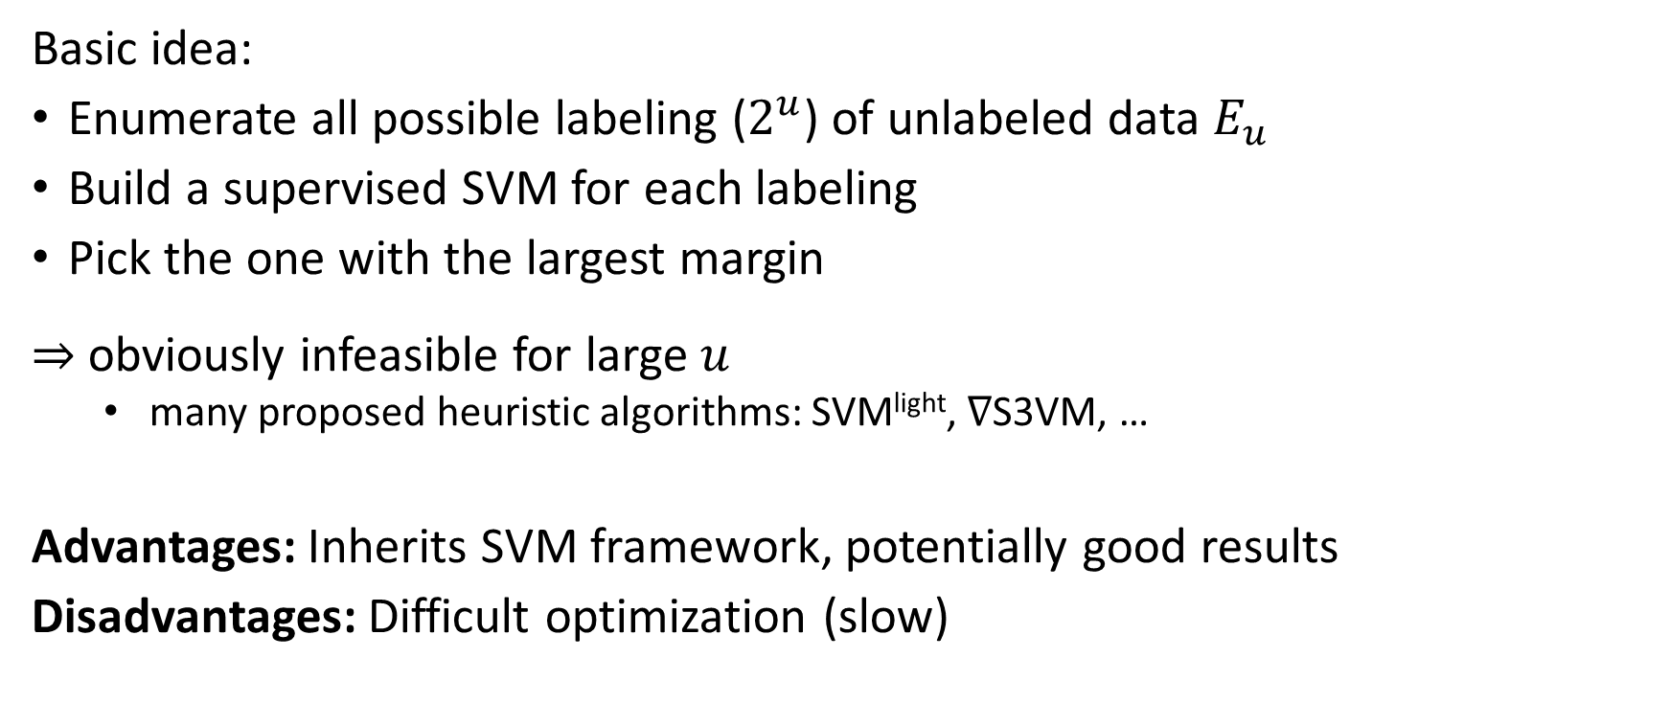
Semi-supervised support vector machines
Basic idea:
Enumerate all possible labeling ($2^{u}$) of unlabeled data $E_{u}$
Build a supervised SVM for each labeling
Pick the one with the largest margin
$⇒$ obviously infeasible for large $u$
many proposed heuristic algorithms: SVM^{light}, ∇S3VM, …
Advantages: Inherits SVM framework, potentially good results
Disadvantages: Difficult optimization (slow)

Slide 31
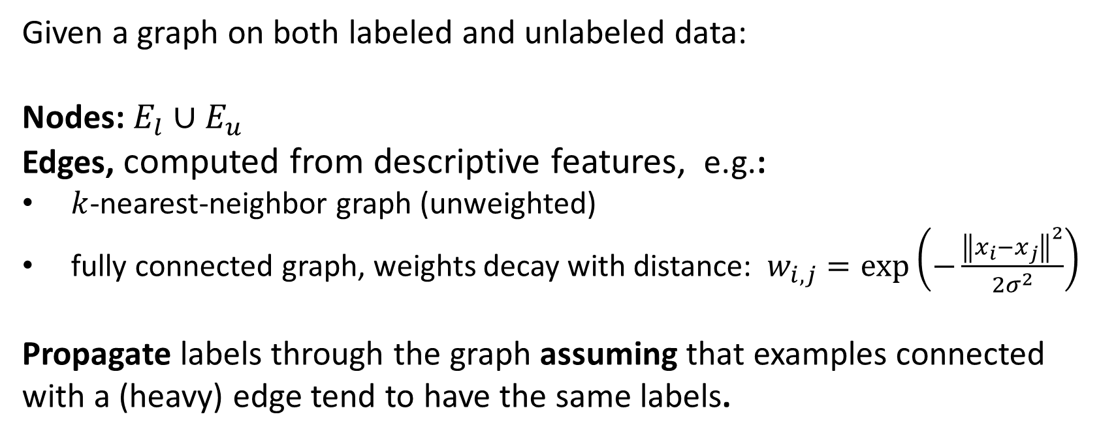
4) Graph based methods
Given a graph on both labeled and unlabeled data:
Nodes: $E_{l}∪E_{u}$
Edges, computed from descriptive features, e.g.:
$k$-nearest-neighbor graph (unweighted)
fully connected graph, weights decay with distance: $w_{i,j}=\exp\left(−\frac{{\left\|x_{i}−x_{j}\right\|}^{2}}{{2σ}^{2}}\right)$
Propagate labels through the graph assuming that examples connected with a (heavy) edge tend to have the same labels.

Slide 32
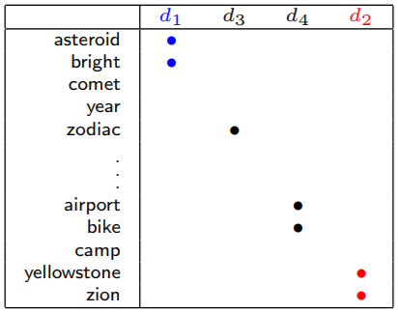
Example
Classify articles: astronomy vs. travel
Similarity measured by word overlap
Figure: Zhu, ICML 2007

Slide 33
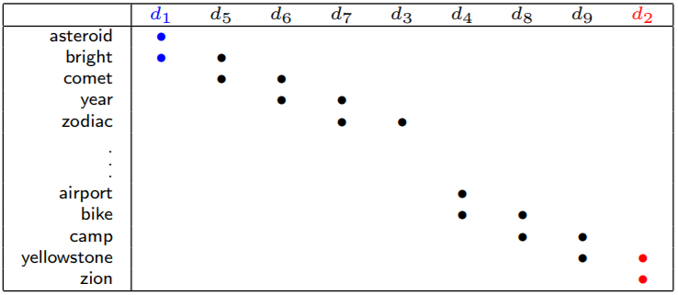
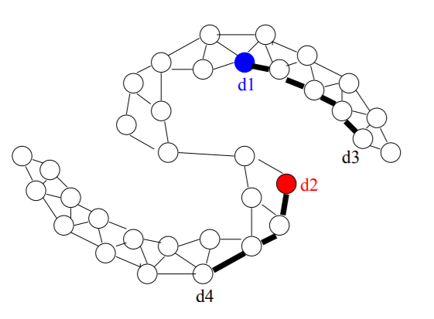
Example
Classify articles: astronomy vs. travel
Similarity measured by word overlap
Figure: Zhu, ICML 2007

Slide 34
Graph based methods
Label propagation algorithms
Mincut
Harmonic
Local and global consistency
Manifold regularization
Advantages:
Good performance if the graph fits the task
Disadvantages:
Sensitive to graph structure and edge weights
Inherently transductive

Slide 35
Summary (1st part)
Unlabeled data can help, but there is no guarantee it will
Model‘s assumptions have to comply with the data at hand
In semi-supervised learning there are no „universally“ good methods (such as, e.g., Random Forests in supervised learning)
When semi-supervised learning will work is not a resolved question
Focus shifts to development of „safe“ semi-supervised methods
Better or at least the same performance as supervised learning

Slide 36
Literature:
Zhu, X., and Goldberg, A. (2009). Introduction to semi-supervised learning, Morgan&Claypool [book, introductory level]
Chapelle, O., Schölkopf, B., & Zien, A. (2006). Semi-supervised Learning. Cambridge, Massachusetts: MIT Press. [book, advanced level]
Zhu (2008) Semi-Supervised Learning Literature Survey, Technical Report, University of Wisconsin, Madison
Triguero, I., García, S., and Herrera, F. (2015) Self-Labeled Techniques for Semi-Supervised Learning: Taxonomy, Software and Empirical Study. Knowledge and Information Systems. [self-training methods]
Ding, S., Zhu, Z. & Zhang, X. (2017). An overview on semi-supervised support vector machine, Neural Computing and Applications.
Subramanya, A., & Talukdar, P. P. (2014). Graph-based semi-supervised learning. Synthesis Lectures on Artificial Intelligence and Machine Learning.

Slide 37
Software for semi-superviesd learning
SSL for Weka (https://github.com/fracpete/collective-classification-weka-package)
Keel (Self-training-alike methods, http://www.keel.es/)
RSSL (Semi-supervised learning in R, https://github.com/jkrijthe/RSSL)
Scikit-learn (Label propagation, EM, http://scikit-learn.org)
Semi-supervised SVM (http://svmlight.joachims.org/)
List of software (not up to date, http://pages.cs.wisc.edu/~jerryzhu/ssl/software.html)

Slide 38
Semi-supervised learning for multi-target prediction - Semi-supervised predictive clustering trees - Self-training with ensembles of PCTs

Slide 39
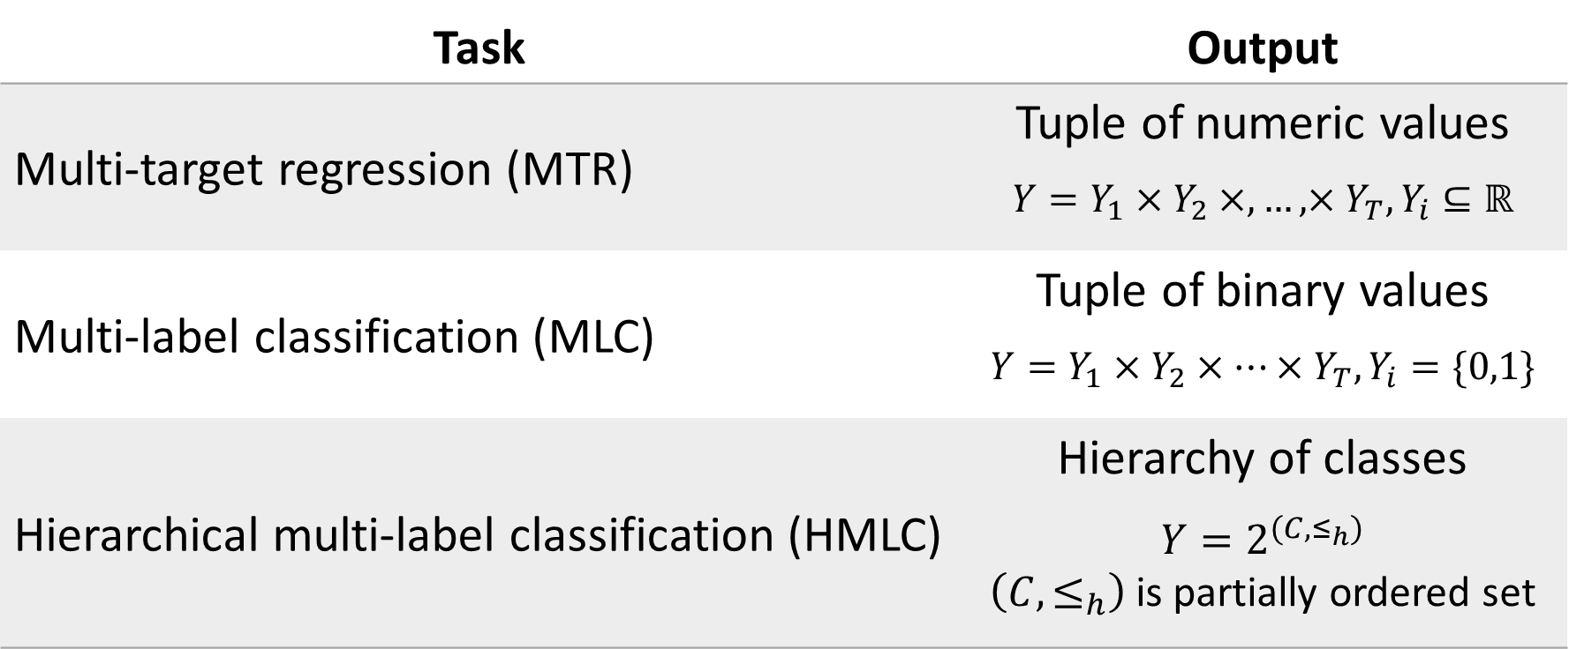
Multi-target prediction tasks
Task | Output
Multi-target regression (MTR) | Tuple of numeric values $$Y=Y_{1}×Y_{2}×,…,×Y_{T},Y_{i}⊆ℝ$$
Multi-label classification (MLC) | Tuple of binary values $$Y=Y_{1}×Y_{2}×…×Y_{T},Y_{i}=\{0,1\}$$
Hierarchical multi-label classification (HMLC) | Hierarchy of classes $$Y=2^{(C,≤_{h})}$$ $\left(C,≤_{h}\right)$ is partially ordered set

Slide 40
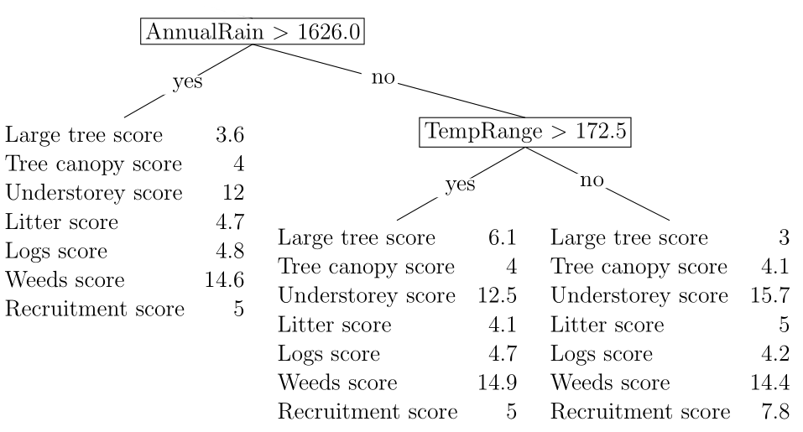

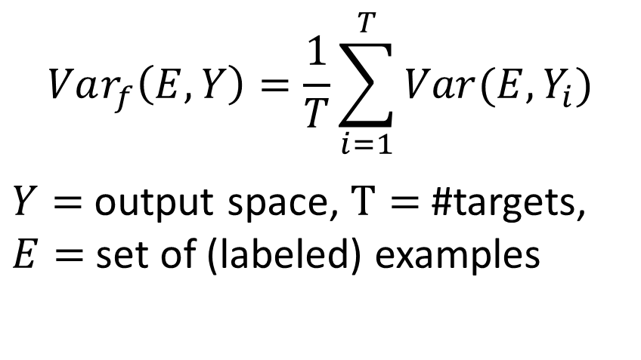
Supervised Predictive Clustering Trees (PCTs)
Decision tree ⬄ Hierarchy of clusters
Variance function (evaluates splits)
$$Var_{f}\left(E,Y\right)=\frac{1}{T}\sum_{i=1}^{T}{Var(E,Y_{i})}$$
$Y=$ output space, $T=$ #targets, $E=$ set of (labeled) examples
Clusters are coherent only in output (target) space
Prototype function
(assigns labels)

Slide 41
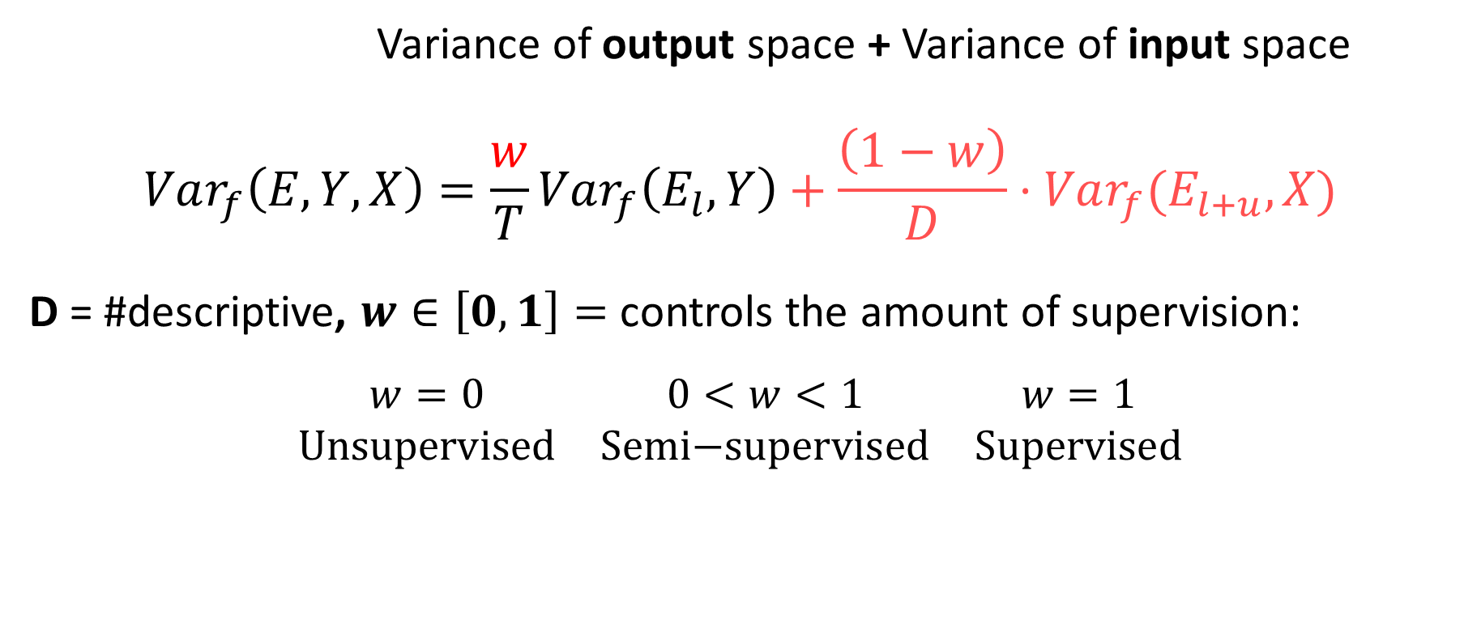
Semi-supervised predictive clustering trees
Variance of output space + Variance of input space
$$Var_{f}\left(E,Y,X\right)=\frac{w}{T}Var_{f}\left(E_{l},Y\right)+\frac{\left(1−w\right)}{D}⋅Var_{f}(E_{l+u},X)$$
D = #descriptive, $w∈\left[0,1\right]=$controls the amount of supervision:
$$\begin{matrix}w=0 & 0<w<1 & w=1 \\ \text{Unsupervised} & \text{Semi}\text{−}\text{supervised} & \text{Supervised}\end{matrix}$$
Levatić et al. (2018) Information Sciences

Slide 42
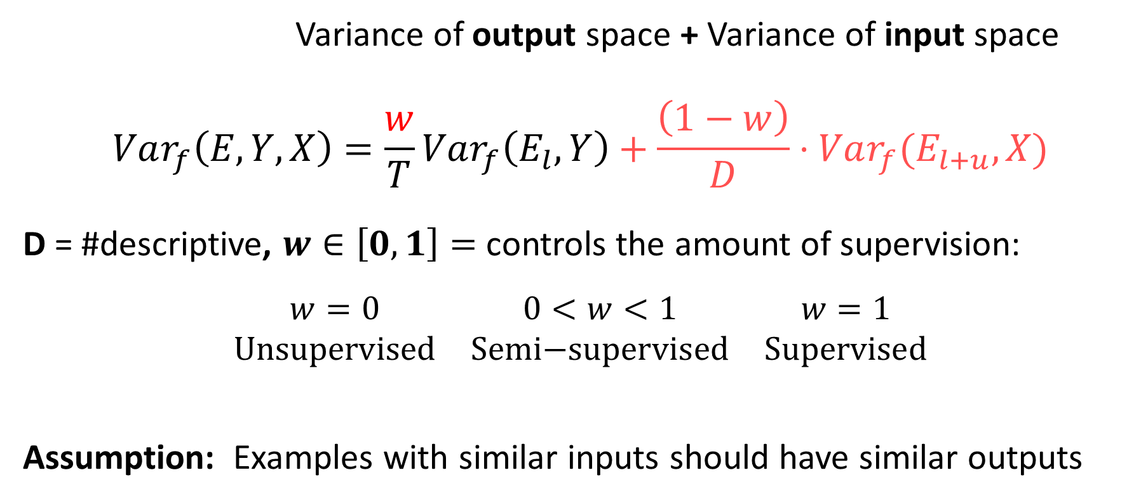
Semi-supervised predictive clustering trees
Variance of output space + Variance of input space
$$Var_{f}\left(E,Y,X\right)=\frac{w}{T}Var_{f}\left(E_{l},Y\right)+\frac{\left(1−w\right)}{D}⋅Var_{f}(E_{l+u},X)$$
D = #descriptive, $w∈\left[0,1\right]=$controls the amount of supervision:
$$\begin{matrix}w=0 & 0<w<1 & w=1 \\ \text{Unsupervised} & \text{Semi}\text{−}\text{supervised} & \text{Supervised}\end{matrix}$$
Assumption: Examples with similar inputs should have similar outputs
Clusters are coherent in both input and output spaces
Levatić et al. (2018) Information Sciences

Slide 43
Evaluation in semi-supervised learning
Can we improve over supervised counterparts?
Influence of the amount of unlabeled data to performance? (we expect SSL to win when there is less unlabeled examples)
„Academic“ evaluation – unlabeled data is simulated
No standard evaluation procedure (e.g., like 10-fold XV in supervised)
 | Descriptive space |  |  |  | Target space
Example 1 | 1 | TRUE | 0.49 | 0.69 | 0.68 | 3.91
Example 2 | 2 | FALSE | 0.08 | 0.07 | 0.56 | 7.59
Example 3 | 1 | FALSE | 0.08 | 0.07 | 0.10 | 7.57
Example 4 | 2 | TRUE | 0.49 | 0.69 | 0.08 | 8.86
Example 5 | 3 | FALSE | 0.12 | 0.77 | 1.24 | 9.21
Arbitrary ratio (labeled vs. unlabeled)
 | Descriptive space |  |  |  | Target space
Example 1 | 1 | TRUE | 0.49 | 0.69 | 0.68 | 3.91
Example 2 | 2 | FALSE | 0.08 | 0.07 | 0.56 | 7.59
Example 3 | 1 | FALSE | 0.08 | 0.07 | ? | ?
Example 4 | 2 | TRUE | 0.49 | 0.69 | ? | ?
Example 5 | 3 | FALSE | 0.12 | 0.77 | ? | ?
Test
External test set
SSL
Inductive evaluation
Test
Transductive evaluation

Slide 44
Results: Experimental setup
Comparison:
Supervisd PCTs (PCT) vs. Semi-supervised PCTs (SSL-PCT)
Supervised random forests (RF) vs. Random forest of SSL-PCTs (SSL-RF)
Datasets: ecology, economy, biology, astronomy, text, audio, images, ...
Labeled data: 50, 100, 200, 350, 500 labeled examples
Selected at random, the rest is unlabeled
10 random repetitions
Evaluation: Unlabeled data = Test set (Transductive)

Slide 45
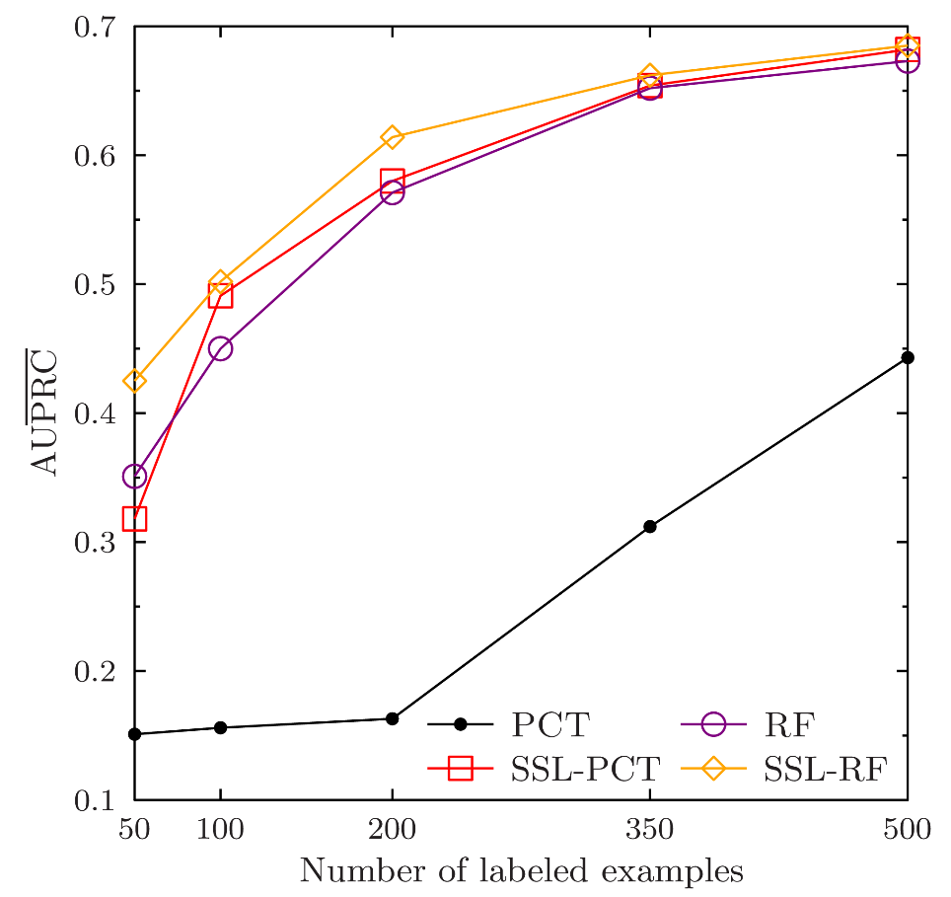
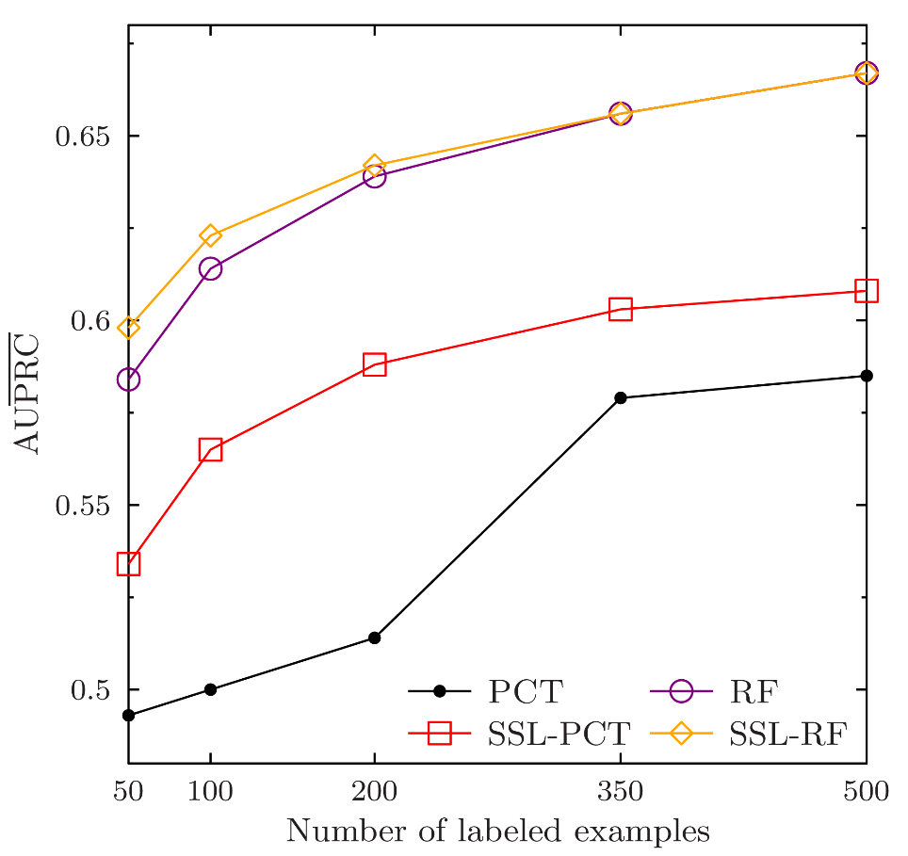
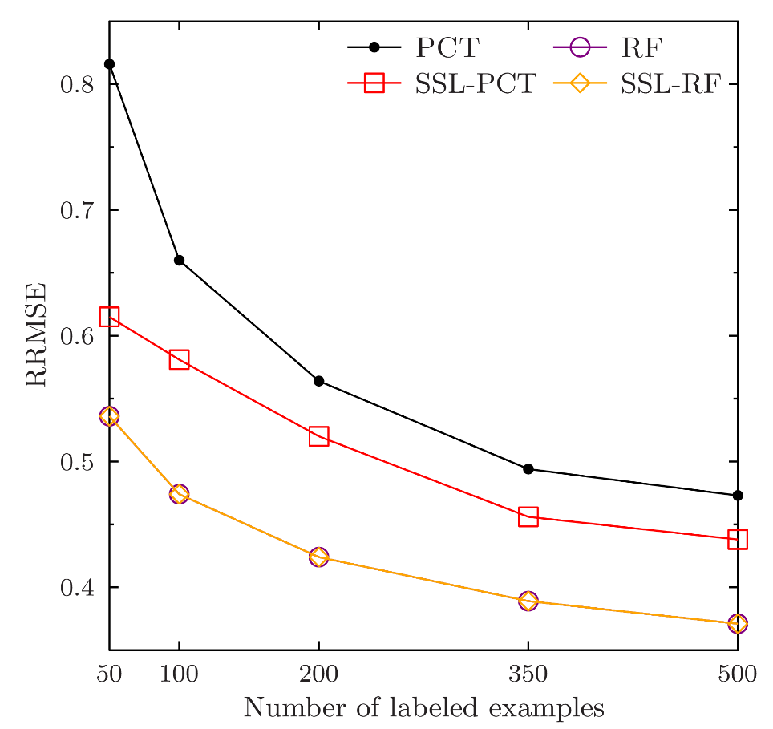
Results: Examples
Multi-label classification
(Medical dataset)
Hierarchical MLC
(Enron dataset)
Multi-target regression
(RF1 dataset)

Slide 46
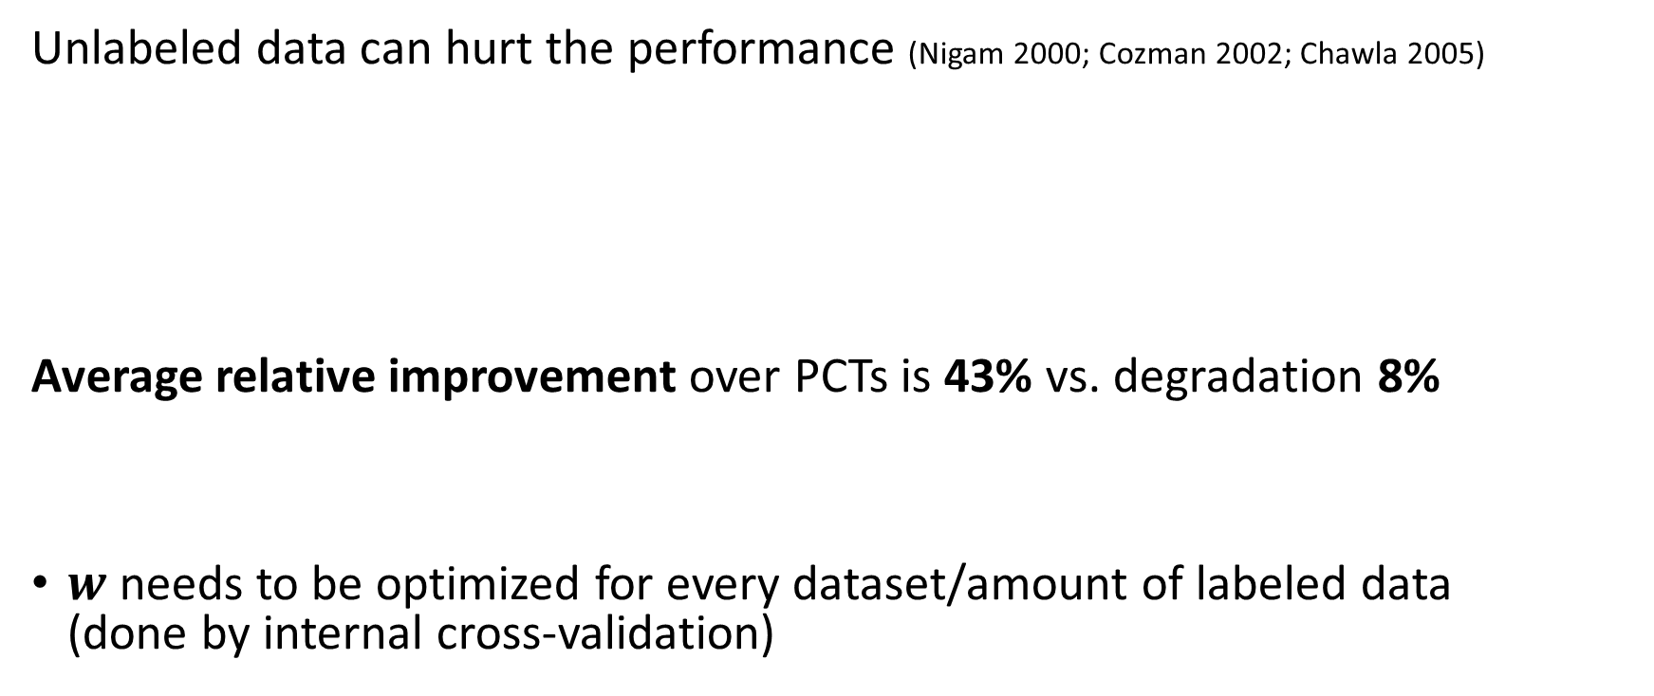


Results: Influence of the $w$ parameter
Unlabeled data can hurt the performance (Nigam 2000; Cozman 2002; Chawla 2005)
Average relative improvement over PCTs is 43% vs. degradation 8%
$w$needs to be optimized for every dataset/amount of labeled data (done by internal cross-validation)
180 experiments | Wins | Ties | Loses
SSL-PCT vs. PCT | 67% | 25% | 8%
$w$provides safety mechanism!

Slide 47
Semi-supervised learning for multi-target prediction - Semi-supervised predictive clustering trees - Self-training with ensembles of PCTs

Slide 48


Self-training with ensembles of PCTs
Scores
Labeled data $E_{l}$
Unlabeled data $E_{u}$
Variance of votes
Learn a random forest of PCTs
Make predictions
Calculate reliability of predictions
Thresholding procedure
Automatic threshold selection based on OOB
Stopping criterion
Add most reliable to labeled set
Select most reliable predictions
No
Stopping criteria
Airbag (Leistner 2009)
Yes
Predictive model
Levatić et al. (2017) Knowledge-based Systems

Slide 49
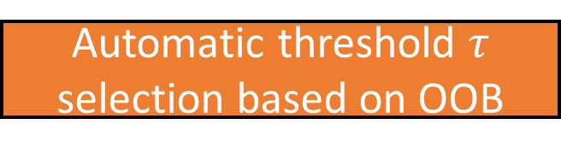
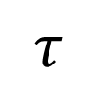
Self-training with ensembles of PCTs
Scores
Reliabe prediction ⇨ ensemble members voted similarly (low variance of votes)
- Aggregated over target variables
Variance of votes
Thresholding procedure
$$τ$$
Estimate how reliable is the reliability score
Automatic threshold $τ$ selection based on OOB
Reliability
Stopping criteria
Monitor out-of-bag error on labeled data, if it increases, stop self-training.
Airbag (Leistner 2009)
Levatić et al. (2017) Knowledge-based Systems

Slide 50
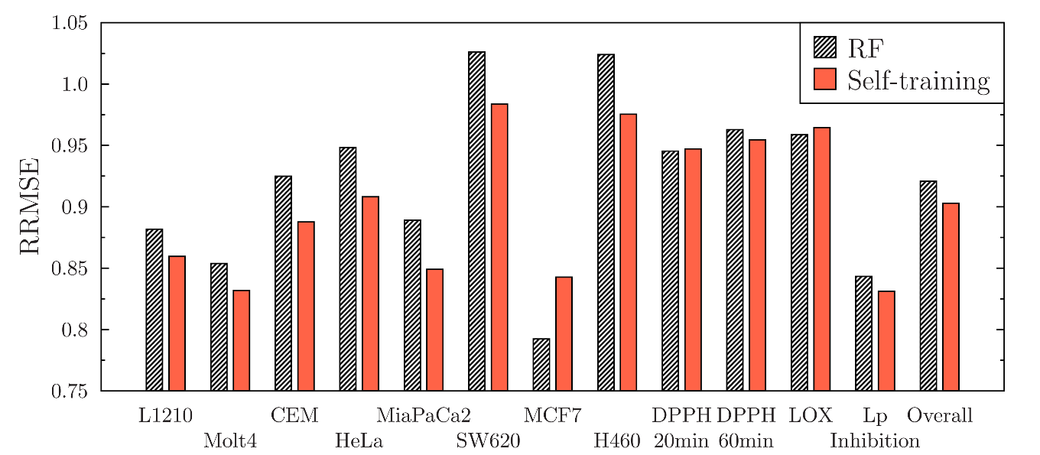
Results: prediction of properties of potential new antimalarial medications
ChEMBL
Database
(www.ebi.ac.uk/chembl/)
Tanimoto similarity > $τ$
True unlabled data
Labeled data
Unlabeled data
$≈$400,000 Compounds
~60 Compounds
Learn
Self-training with ensembles of PCTs
Levatić et al., IPSSC 2015

Slide 51
Other semi-supervised methods for multi target prediction
Kernelized Bayesian Matrix Factorization
Gönen, M. & Kaski, S. (2014). IEEE Transactions on Pattern Analysis and Machine Intelligence, 36(10), 2047-2060.
Multi-target regression and multi-label classification
Input output kernel regression
Brouard, C., Szafranski, M., & d'Alché-Buc, F. (2016). Journal of Machine Learning Research, 17(176), 1-48.
Multi-target regression and multi-label classification

Slide 52
Summary (2nd part)
Semi-supervised predictive clustering trees
Interpretable
Efficient
(Quite) safe to use
Extend naturally to ensembles
Handle (hierarchical) multi-label classification and multi-target regression
Self-training with ensembles of predictive clustering trees
Not so efficient (iterative learning) and not so safe (error propagation)
Can outperform supervised Random Forests

Slide 53
Software
Semi-supervised learning for multi-target prediction
CLUS (http://source.ijs.si/ktclus/clus-public/)
Implements semi-supervised predictive clustering trees and ensembles
(Hierarchical) multi-label classification, multi-target regression
KBMF (https://github.com/mehmetgonen/kbmf)
Gönen, M. & Kaski, S. (2014). Kernelized Bayesian Matrix Factorization, IEEE Transactions on Pattern Analysis and Machine Intelligence
Multi-label classification, multi-target regression

Slide 54
Literature
Levatić, J., Kocev, D., Ceci, M., Džeroski, S. (2018) Semi-supervised trees for multi-target regression, Information Sciences
Levatić, J., Ceci, M., Kocev, D., Džeroski, S. (2017) Self-training for multi-target regression with tree ensembles, Knowledge-Based Systems
Levatić, J., Ceci, M., Kocev, D., Džeroski, S. (2017) Semi-supervised classification trees, Journal of Intelligent Information Systems
Levatić, J. (2017) Semi-supervised learning for structured output prediction, PhD thesis

Slide 55
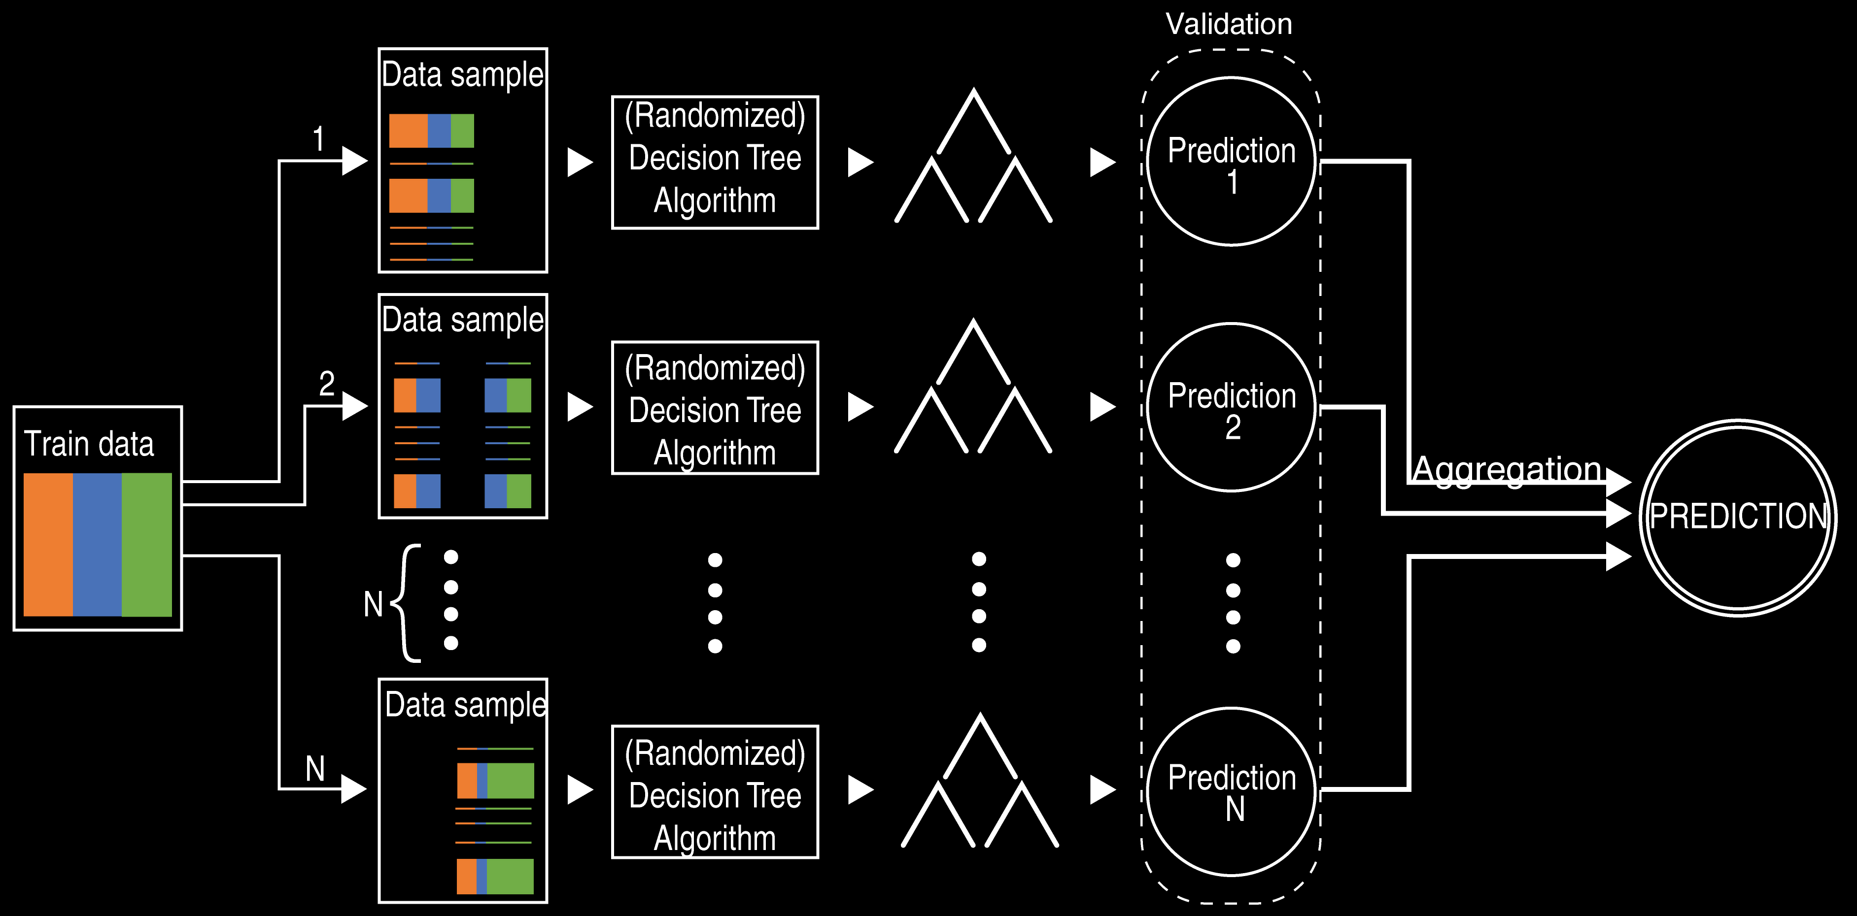
Random Forest

